Slide 1
Networking & Firewalls
Cyrus Jian Bonyadi, PhD CMSC ‘21
(@pleoxconfusa)

Slide 2
Outline
Background Information
CIA Triad
Preliminary Example
Networks
OSI Model
5 Layer Model, explained
Tools
Network Security
Least Privilege
Firewalls
Lab
Linux
Windows

Slide 3
Background Information

Slide 4
CIA Triad
Confidentiality: privacy of data
encryption, protocols
Integrity: accuracy of data
checksums, authentication/signatures, protocols
Availability: access to data
firewalls, routing

Slide 5
Preliminary Example

Slide 6
Preliminary Example

Slide 7
Preliminary Example
What is the easiest way to protect good users?

Slide 8
Preliminary Example

Slide 9
Preliminary Example

Slide 10
Preliminary Example
Problem: Confidentiality and Integrity without Availability

Slide 11
Networks

Slide 12
Network Fundamentals
Application
Presentation
Application
Session
Transport
Transport
Network
Network
Data Link
Data Link
Physical
Physical
5 Layer
OSI Model

Slide 13
Network Fundamentals
Application
Presentation
Application
Session
Transport
Transport
Network
Network
Data Link
Data Link
Physical
Physical
5 Layer
OSI Model

Slide 14
Network Fundamentals
Application
Presentation
Session
Transport
Network
Data Link
Physical
OSI Model - Official model

Slide 15
Network Fundamentals
Application
Transport
Network
Data Link
Physical
5 Layer - Easier to teach

Slide 16
Physical
Application
The hard link between machines.
Transport
Network
Data Link
Physical

Slide 17
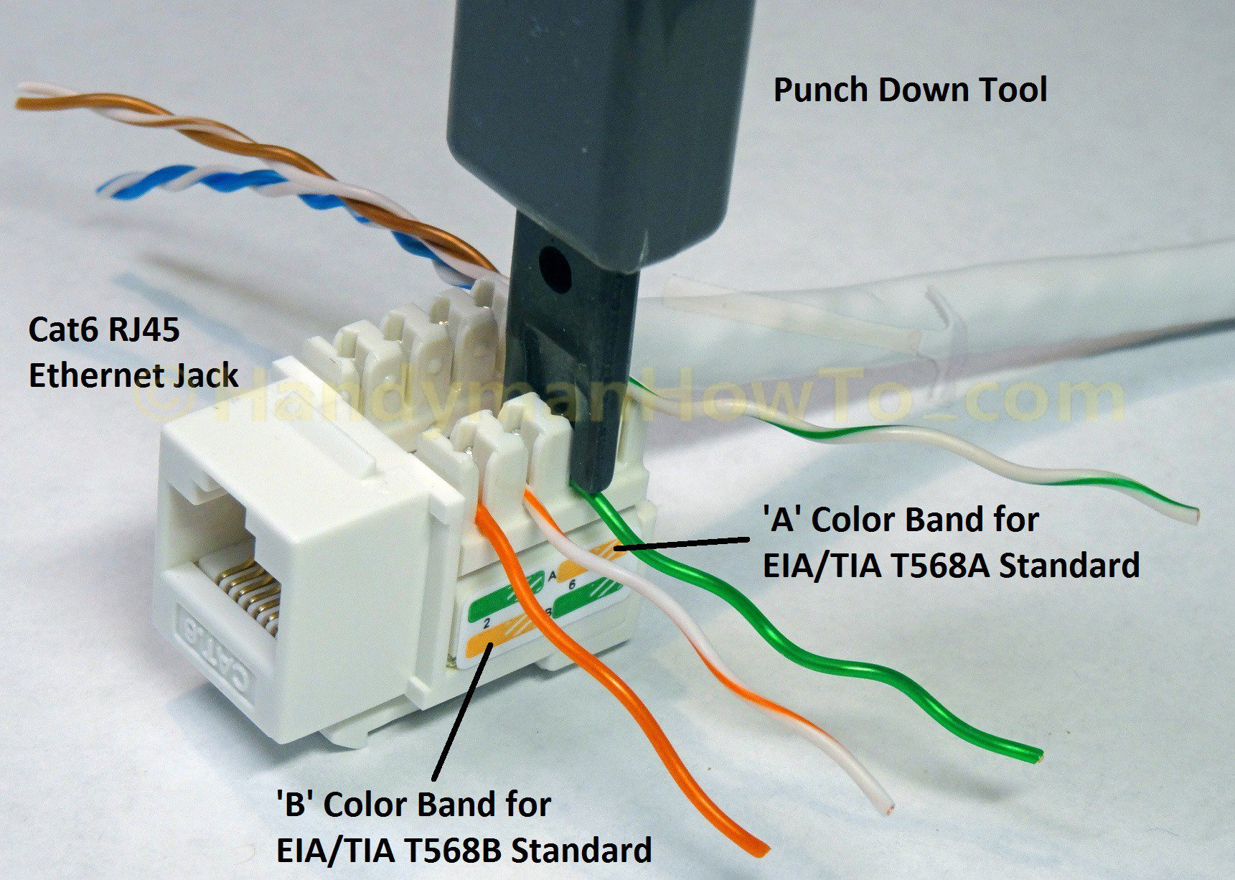

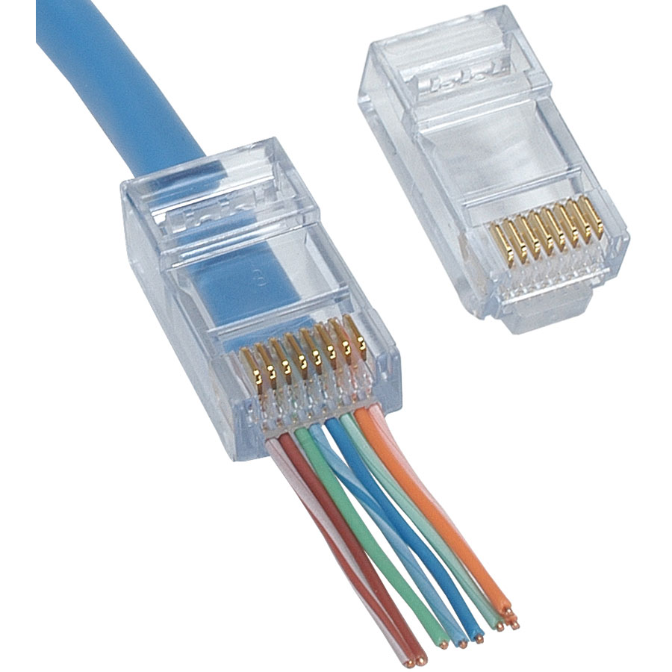
Physical
Application
Transport
Network
Data Link
Physical
https://www.goodfreephotos.com/albums/vector-images/wifi-connection-symbol-vector-file.png
https://www.handymanhowto.com/wp-content/uploads/2016/12/Cat6-Ethernet-Jack-Punchdown-Wiring.jpg
https://www.parts-express.com/Data/Default/Images/Catalog/Original/150-714_HR_0.jpg

Slide 18
Physical
Application
How do we secure this?
Wired
Disconnect it.
Fiber instead of ethernet.
Wireless
WPA3 (WPA2 KRACK)
Appropriate zoning
Other ideas?
Transport
Network
Data Link
Physical

Slide 19
Data Link
Application
The physical identity of devices.
Example: 01:34:67:9A:CD:F0
Transport
Network
Data Link
Physical

Slide 20
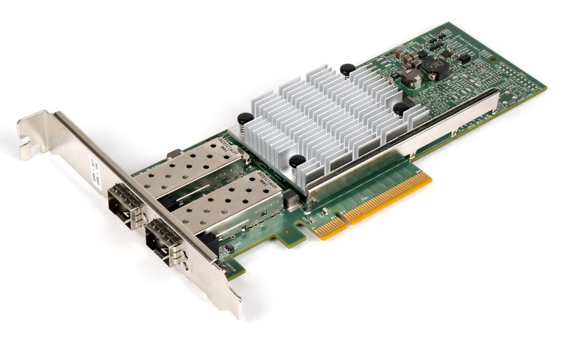


Data Link
00:82:05:9A:D3:BD
Application
Transport
Network
Data Link
Physical
https://icon-library.net/images/switch-icon-png/switch-icon-png-25.jpg
https://www.lifewire.com/thmb/wSluszBhz3JJi_9DRVhXAP1PJ58=/768x0/filters:no_upscale():max_bytes(150000):strip_icc()/Qle3442-cu_10gbe_nic-5aee673cff1b780036491a47.jpg
https://www.bluetooth.com/wp-content/uploads/2019/04/Bluetooth_FM_Color.png

Slide 21
Data Link
Application
How do we secure this?
What can be done:
Encryption (VLANs)
Flood prevention
What cannot be solved:
Spoofing can be detected but not resolved.
Others ideas?
Transport
Network
Data Link
Physical

Slide 22
Network
Application
The identity within a network
The identity between networks
Transport
Network
Data Link
Physical

Slide 23
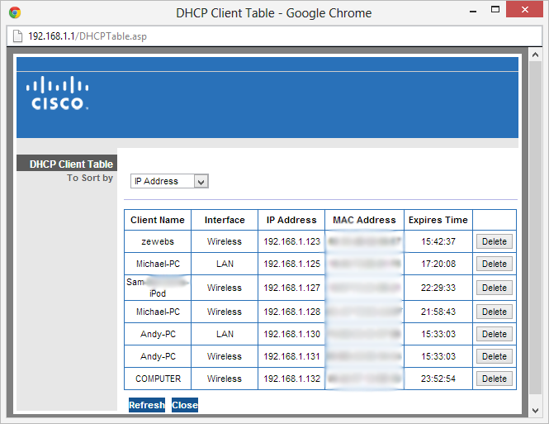
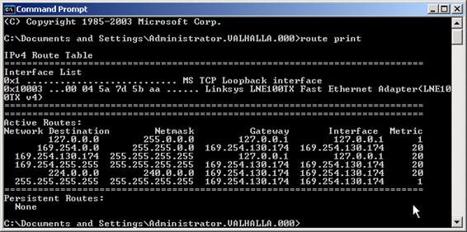
Network
Application
Transport
Network
Data Link
Physical
https://i.stack.imgur.com/mjLjP.png
https://www.sqa.org.uk/e-learning/NetInf104CD/images/pic004.jpg

Slide 24
Network
Application
How do we secure this?
Firewalls!
Filtering
Zoning
Routers
Proper configuration
Private vs. public IPs
Other ideas?
Transport
Network
Data Link
Physical

Slide 25
Transport
Application
The protocols to communicate
Transport
ex: TCP
UDP
Network
Data Link
Physical

Slide 26
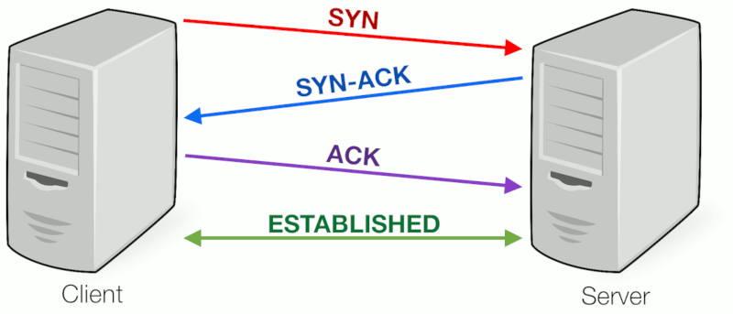
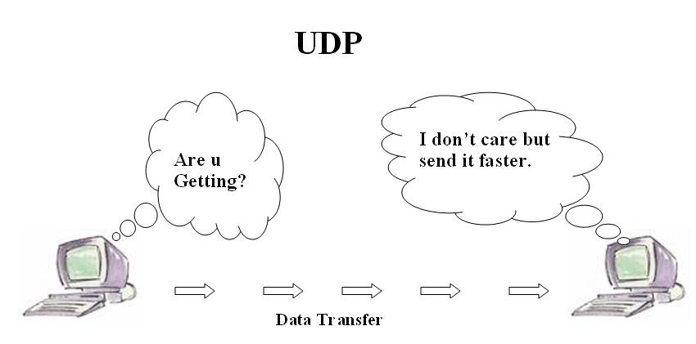
Transport
Application
Transport
Network
Data Link
Physical
https://www.coengoedegebure.com/content/images/2018/09/handshake.png
https://upload.wikimedia.org/wikipedia/commons/0/0f/Fig2_UDPwork.jpg

Slide 27
Application and Everything Else
Application
Programs using networks
Transport
Network
Data Link
Physical

Slide 28



Application and Everything Else
Application
Transport
Network
Data Link
Physical
https://cdn.vox-cdn.com/thumbor/AycIQrzQvrHuoZLJNa6LVYZ1zMA=/0x0:1280x720/1200x800/filters:focal(538x258:742x462)/cdn.vox-cdn.com/uploads/chorus_image/image/65311063/origin.0.jpg
https://upload.wikimedia.org/wikipedia/commons/thumb/5/51/IMessage_logo.svg/1024px-IMessage_logo.svg.png
https://regmedia.co.uk/2017/07/28/shutterstock_facebook3.jpg?x=442&y=293&crop=1

Slide 29
Tools
Some useful tools for analyzing network traffic.
ping - Sends ICMP Echo Request packets
netcat (nc) - Lets you send arbitrary data over TCP or UDP
tcpdump - captures and dumps traffic on a network interface
tshark - more featureful tcpdump
Wireshark - GUI tool to create and analyze packet captures
curl/wget/httpie - let you make lots of HTTP requests
nmap - network mapper (more on this later)
scapy - Python library to do all kinds of things with packets

Slide 30
Network Security

Slide 31
Least Privilege
Maintain availability while being as close to disconnected as possible.
Minimums required for operation:
Minimum permissions
Minimum services
Minimum access

Slide 32
Least Privilege Example
Running:
SSH
Docker API
HTTP

Slide 33
Least Privilege Example
Running:
SSH
Docker API
HTTP

Slide 34
Least Privilege Example
130.85.56.40/29
Running:
SSH
Docker API
HTTP
172.21.254.152

Slide 35
Least Privilege Example
130.85.56.40/29
Running:
SSH
Docker API
HTTP
172.21.254.152

Slide 36
Least Privilege Example
umbccd.net
=
130.85.56.45
130.85.56.40/29
Running:
SSH
Docker API
HTTP
172.21.254.152

Slide 37
Least Privilege Example
umbccd.net
=
130.85.56.45
NAT Translations:
130.85.56.40/29
Running:
SSH
Docker API
HTTP
172.21.254.152

Slide 38
Least Privilege Example
umbccd.net
=
130.85.56.45
NAT Translations:
130.85.56.45
-> 172.21.254.152
130.85.56.40/29
Running:
SSH
Docker API
HTTP
172.21.254.152

Slide 39
Least Privilege Example
umbccd.net
=
130.85.56.45
NAT Translations:
130.85.56.45
-> 172.21.254.152
130.85.56.40/29
Running:
SSH
Docker API
HTTP
Risks:
Entirely exposed
Others?
172.21.254.152

Slide 40
Least Privilege Example
umbccd.net
=
130.85.56.45
NAT Translations:
130.85.56.45
-> 172.21.254.152
130.85.56.40/29
Running:
SSH
Docker API
HTTP
Benefits:
Availability to all services
Others?
172.21.254.152

Slide 41
Least Privilege Example
umbccd.net
=
130.85.56.45
NAT Translations:
130.85.56.45
-> 172.21.254.152
130.85.56.40/29
Running:
SSH
Docker API
HTTP
What can be done instead?
172.21.254.152

Slide 42
Least Privilege Solution 1
umbccd.net
=
130.85.56.45
NAT Translations:
130.85.56.45:80
-> 172.21.254.152:80
130.85.56.40/29
Running:
SSH
Docker API
HTTP
172.21.254.152

Slide 43
Least Privilege Solution 2
umbccd.net
=
130.85.56.45
NAT Translations:
130.85.56.45
-> 172.21.254.152
130.85.56.40/29
Firewall Rules:
Only Allow :80
Block :2576
Block :22
Running:
SSH
Docker API
HTTP
172.21.254.152

Slide 44
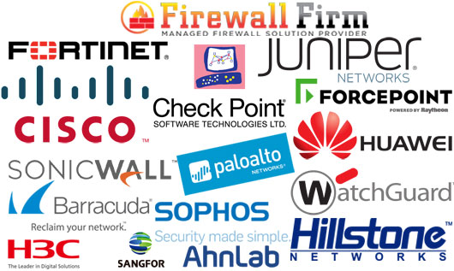
Firewalls
https://cdn.shortpixel.ai/client/q_lossy,ret_img/https://firewall.firm.in/wp-content/uploads/2018/09/Firewall_Banner.jpg

Slide 45
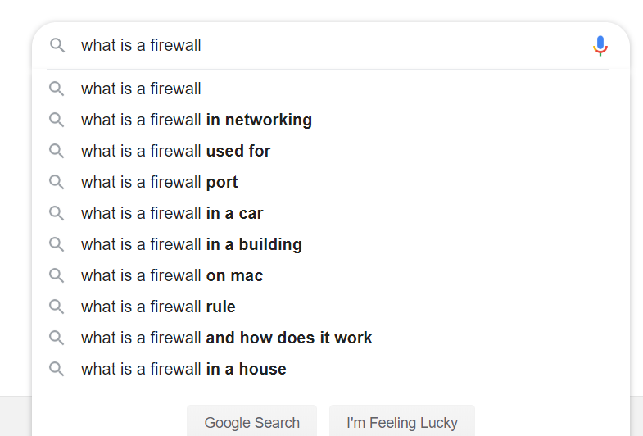
What is a firewall?
google.com

Slide 46
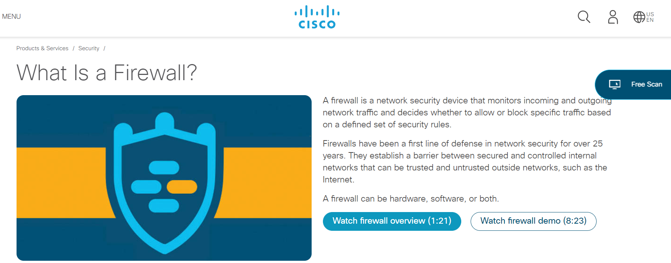
What is a firewall?
https://www.cisco.com/c/en/us/products/security/firewalls/what-is-a-firewall.html

Slide 47
What is a firewall?
A firewall is a network security device that monitors incoming and outgoing network traffic and decides whether to allow or block specific traffic based on a defined set of security rules.
Examples on Servers: iptables, ipfw, pf (packet filter), Windows Firewall.
Capabilities:
Blacklist: explicitly block some content (illegal to block by IP in competitions)
Whitelist: explicitly allow some content
Filter by protocol (transport layer)
Conduct packet inspection (application layer)
Can perform some capabilities of a router.
https://www.cisco.com/c/en/us/products/security/firewalls/what-is-a-firewall.html

Slide 48
Firewalls Used in Lab
Linux - iptables
Used with the “iptables” command.
Primarily filters communication by ip address and port.
Can filter by packet content.
Windows - Windows Firewall
Used with the Windows Firewall application.
Primarily manages communication of applications on a system.
Can filter by ip address and port.
iptables
Windows Firewall

Slide 49
Lab

Slide 50
Summary
In this lab, you will:
be learning how to manipulate availability to improve security.
gain experience setting up services on both Windows Server and Linux(Ubuntu)
learn how to configure the default firewalls of both systems.

Slide 51
Linux - iptables
iptables has tables, and within each table there are chains Default chains are INPUT, OUTPUT, and FORWARD. Chains execute firewall filtering from top to bottom.
Sample commands:
iptables -P INPUT DROP #changes the policy for the INPUT chain to DROP, which means that any rule not specify is automatically a block rule.
iptables -A OUTPUT -i lo -j ACCEPT #allows all outbound connections to localhost.
iptables -I INPUT -s 130.85.300.4 -p tcp --dport 25 -j DROP #blocks access to SMTP from the IP.

Slide 52
Windows - Windows Firewall
Found in Windows FIrewall, which can be searched for in the system.
Does exist.
The rules do not execute in order, simply by allow or block.

Slide 53
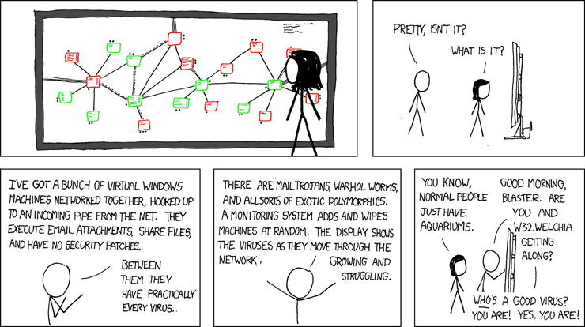
...okay, bye!

